Slide 1
SENTIMENT ANALYSIS

Slide 2
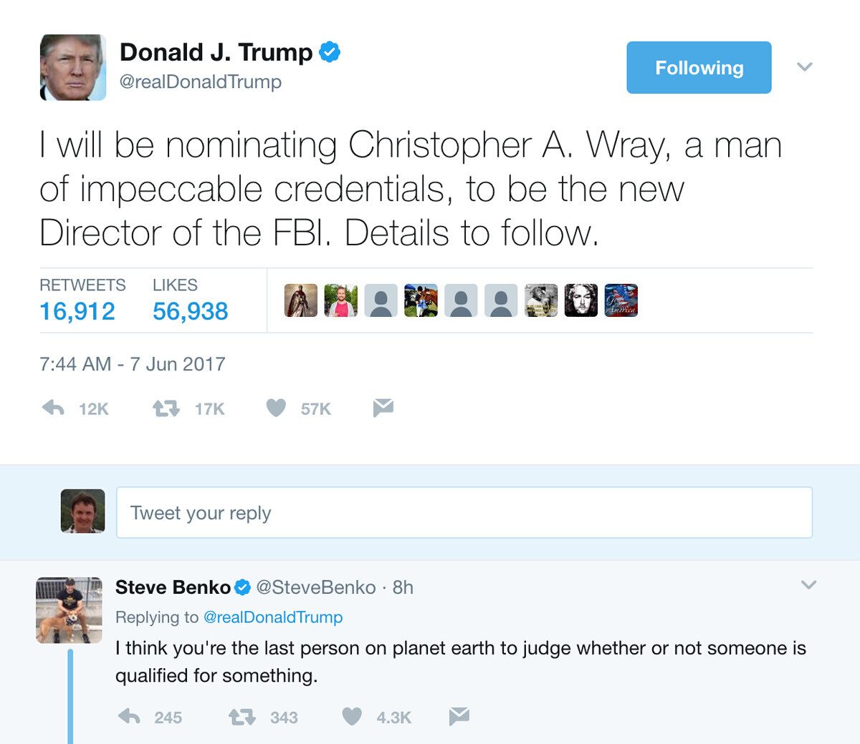
ABSTRACT
The Internet is the most popular medium of sharing thoughts and opinions. It may be the praise of some popular figure or any sorts of criticism-constructive or hatred. Since every other person supports or dismisses options by people, it is easy to judge public opinions based on the mass opinion. Data mining is one such method of gathering all the necessary comments, tweets, thoughts, words and analysing them and using them to guess the thoughts of the public. These days, it is crucial whenever there is assessment of public sentiments on political leaders or to see what they think of celebrities or to see the review of products like cell phones. This paper deals with the topic of sentiment analysis, different ways of doing it and different tools used. It measures the cons of sentiment analysis and projects different outcomes as well.

Slide 3
Sentiment analysis is the process of extracting emotions or opinions from a piece of text for a given topic. it allow us to understand the attitudes, opinions and emotions in the text. In it user‘s likes and dislikes are captured from web content. It involves predicting or analysing the hidden information present in the text. This hidden information is very useful to get insights of user’s likes and dislikes. The aim of sentiment analysis is to determine the attitudes of a writer or a speaker for a given topic. Sentiment analysis can also be applied to audio, images and videos.
Today internet has become the major part of our life. Most of the people use online blogging sites or social networking sites to express their opinions on certain things. They also use these sites to know what other people’s opinions are. Thus mining of this data and sentiment extraction has become an important field of research.
PROBLEM DEFINITION

Slide 4
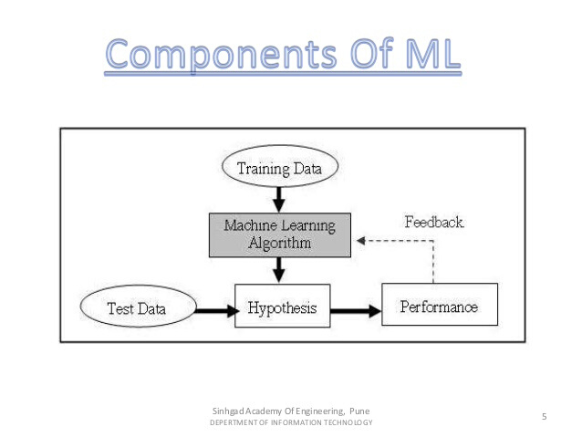

Slide 5
Long short-term memory (LSTM) is an artificial recurrent neural network (RNN) architecture used in the field of deep learning. Unlike standard feedforward neural networks, LSTM has feedback connections. It can not only process single data points (such as images), but also entire sequences of data (such as speech or video). They are well-suited to classifying, processing and making predictions based on time series data, since there can be lags of unknown duration between important events in a time series.
LTSM METHOD

Slide 6
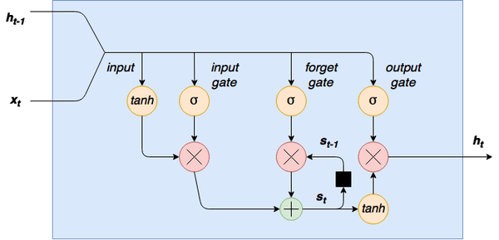

Slide 7
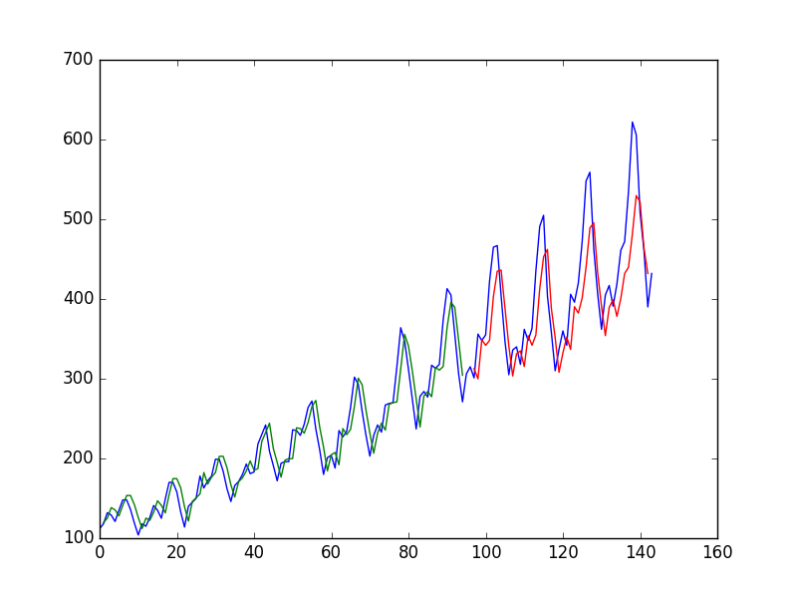
DRAWBACKS
The main drawbacks of this method are that the data sets don’t train as quickly as we expect it to. They also take up a lot of memory and are easy to overfit. They are sensitive to random weight initialisation.

Slide 8
In machine learning, naive Bayes classifier uses Bayes' theorem with strong (naive) independence assumptions between the features which were word frequencies. Naive Bayes classifiers are highly accessible, requires number of parameters which are linear in the number of variables (features/predictors) in the learning problem. Training of Maximum-likelihood can be used for evaluation of a closed form expression which considers linear time, rather than expensive approximate iteration that is used for different types of classifiers.
NAIVE BAYES METHOD
Who we are

Slide 9
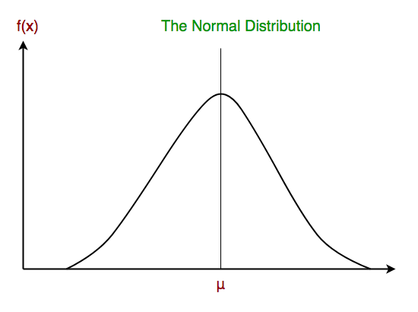

Slide 10
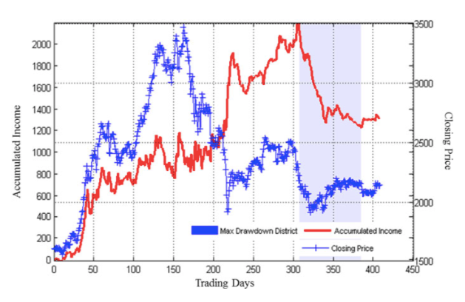
DRAWBACK
The first disadvantage is that the Naive Bayes classifier makes a very strong assumption on the shape of your data distribution, i.e. any two features are independent given the output class. Due to this, the result can be (potentially) very bad - hence, a “naive” classifier

Slide 11
To build a deep-learning model for sentiment analysis, we first have to represent our sentences in a vector space. We represent our sentences with vectors that take into account both the words that appear and the semantic structure. A first way to do this is to represent every word with an n-feature vector, and to represent our sentence with a n*length matrix. We represent every word by an index vector. And we integrate in our deep learning model a hidden layer of linear neurons that transforms these big vectors into much smaller ones.
SUPPORT VECTOR MACHINE

Slide 12
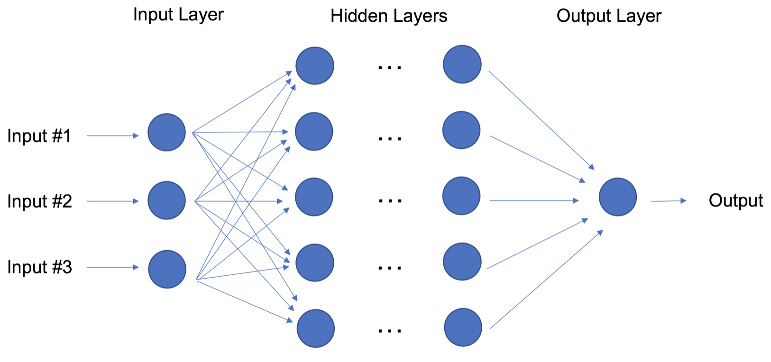
We take these smaller vectors as an input of a convolutional neural network. We train the model as a whole, so that the word vectors we use are trained to fit the sentiment information of the words, i.e. so that the features we get capture enough information on the words to predict the sentiment of the sentence. We will take the features of this word vector as parameters of our model and optimise them using a gradient descent. Doing that, we will have for every sentence a set of features that represent the structure of the sentence. These features capture most of the useful information on how the words follow each other.

Slide 13
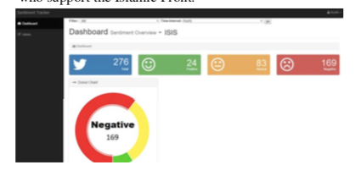
RESULTS
This process is far more accurate with an accuracy of around 82.34% and it can get better with more data sets trained and exposed. this is the best wasy to analyse sentiments.
Who we are

Slide 14

TWITTER
Twitter is a microblogging and social networking service on which users post and interact with messages known as "tweets".

Slide 15
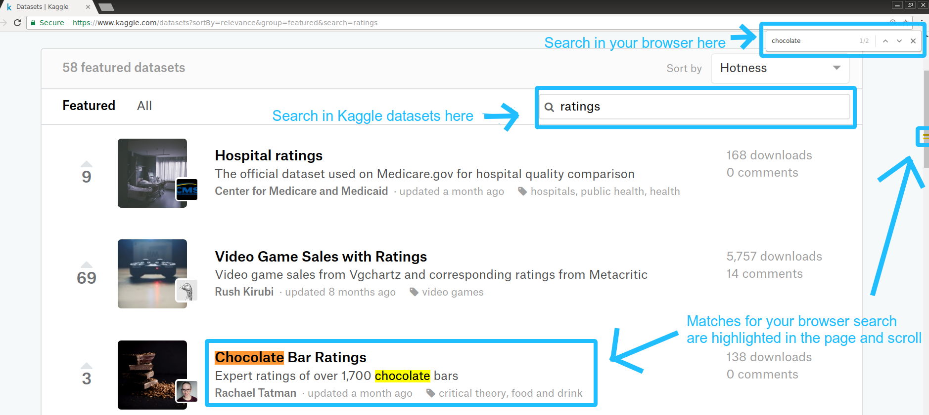
We use twitter API for the SVM method, downloaded from Kaggle

Slide 16
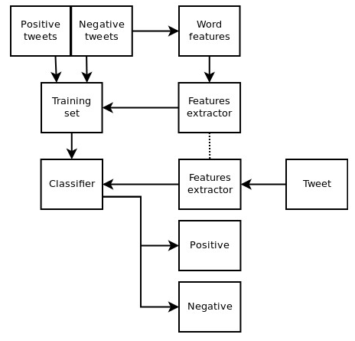
PROPOSED METHOD
SVM method can be done in the following steps
Comstech • Oct. 15, 2020

Slide 17

We collected data from twitter using twitter API. For accessing twitter data, we have to create an app using twitter account which provides credentials (consumer key, consumer secrets, access token and access token secret).
DATA COLLECTION

Slide 18
Preprocessing includes the following things.
• All URL (e.g. www.xyz.com), hash tags (e.g. #topic) and targets (@username) are removed.
• Uppercase letters are converted into lowercase.• All the texts are broken down into tokens. This process is called tokenisation. For example “this is an amazing phone” is broken into individual tokens such „this‟, „is‟, „an‟, „amazing‟ and,,phone‟. On encountering a space, a token is identified.
• Stop words like articles, prepositions, conjunctions, and pronouns are removed. Stop words provide little or
no information.
PREPROCESSING OF DATA

Slide 19
It is the most important tasks related to classification. It includes the removal of
irrelevant words or terms that do not express any sentiment. Unigram (n=1) [14] and term frequency and
inverse document frequency (TF-IDF) [15] is used for feature extraction. The unigram represents
individual and distinct words. The TF-IDF assigns a score to each word. The term- frequency is computed
by counting the number of times a given word or term appeared in given document and inverse document
frequency is computed by dividing the total number of documents by number of documents that has a given
term.
FEATURE EXTRACTION

Slide 20
SVM performs classification by finding an optimal hyper-plane that separates two classes. The optimal hyper-plane has maximum margin. The distance between nearest data point and hyperplane is called as margin. The point that lies nearest to hyper-plane is called support vector.
SVM CLASSIFIER

Slide 21
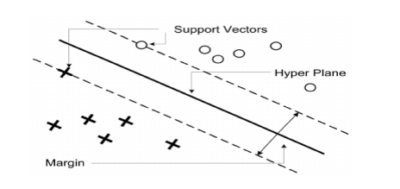
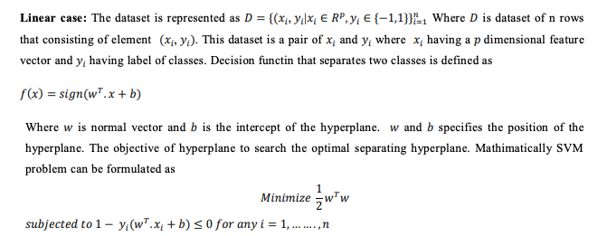

Slide 22
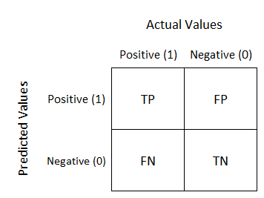

Slide 23
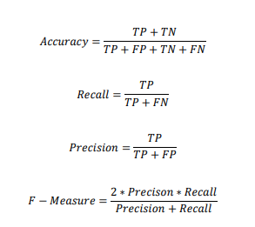
TP-TRUE POSITIVE
FP-FALSE POSITIVE
TN-TRUE NEGATIVE
FN-FALSE NEGATIVE
PERFORMANCE OF ALGORITHM

Slide 24
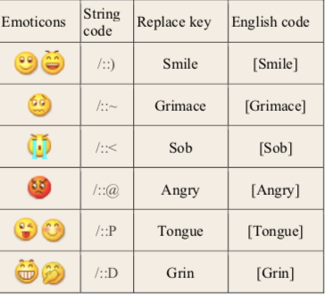
CONCLUSION
In this era of commercialisation, investors look out for the public’s opinions to measure the success rate of their product. People are now free to give suggestions to certain things as well. To determine large scale public opinion, machine learning is the best method. Strategically, people can act according to the public’s opinion to have the maximum advantage.

